Slide 1
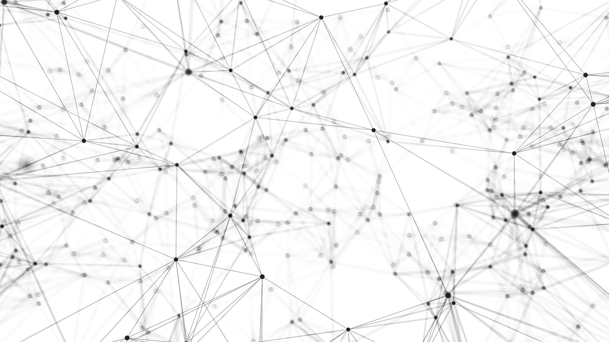
Project 2
glance2 = glance(lm2)
glance2$formula = as.character(fml2)
glance2
Matt Dunaway and Peter Truax

